Slide 1

Dawood University of Engineering & Technology
Sir Syed Ahmed Khan
Pioneer of Muslim Renaissance in South Asia
Founder of the Aligarh Movement &
Muhammadan Anglo-Oriental College (Later AMU)
Presenting By Section : B (Group-2)
&
Course Instructor : Sir Faisal
VED VIYAS (25F-CY-73) : Intro & Early Life
ABDUL BASIT (25F-CY-58) : Movements & Works
MUAWAZ AQEEL (25F-CY-59) : Legacy & Impact
1817 – 1898

Slide 2
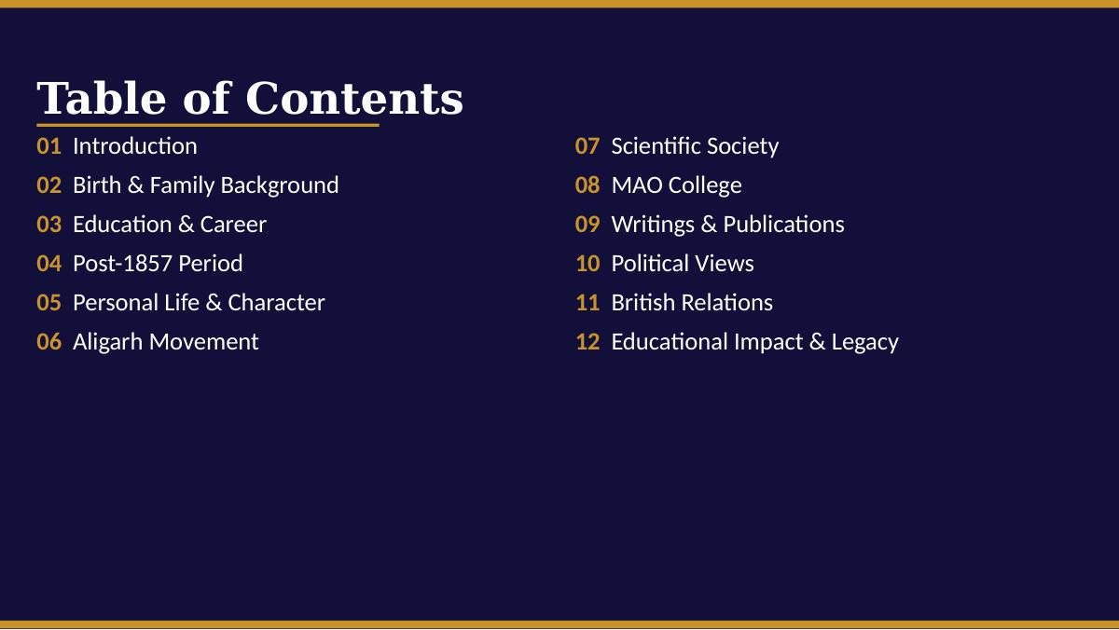
Dawood University of Engineering & Technology
Presenting By Section : B (Group-2)
&
Course Instructor : Sir Faisal

Slide 3
Dawood University of Engineering & Technology
Course Instructor : Sir Faisal
1.VED VIYAS
Introduction &
Early Life
Slides covering who Sir Syed was, his background,
education, and early career.

Slide 4
MEMBER 1
Dawood University of Engineering & Technology
Who Was Sir Syed Ahmed Khan?
A 19th-century Muslim reformer, educator, philosopher and writer from India.
Worked tirelessly to modernize Muslim society during British colonial rule.
Believed that science, reason, and Islamic faith were fully compatible.
Known as the 'Father of Muslim Modernism' in South Asia.
QUICK FACTS
Born:
17 Oct 1817, Delhi
Died:
27 Mar 1898, Aligarh
Profession:
Reformer, Educator, Writer
Known For:
Aligarh Movement, MAO College
Title:
'Sir' (1888 Knighthood)

Slide 5
Dawood University of Engineering & Technology
MEMBER 1
— EARLY LIFE
Birth & Family Background
Born on 17 October 1817 in Delhi — then the heart of the declining Mughal Empire.
Came from a noble ashraf Muslim family with deep roots in Mughal court circles.
His grandfather Fariduddin Khan held a high advisory position under Emperor Akbar Shah II.
His maternal grandfather Khwaja Fariduddin was the Prime Minister of the Mughal Emperor.
Growing up surrounded by scholars, courtiers, and classical Islamic learning shaped his worldview profoundly.
He witnessed the slow collapse of Mughal power firsthand — an experience that drove his passion for Muslim reform.

Slide 6
MEMBER 1
— EDUCATION & CAREER
Education and Government Service
Traditional Education
Government Career
Studied Arabic, Persian, and Islamic theology in the classical tradition.
Received instruction from leading scholars in Delhi.
Self-taught in English and modern subjects later in life.
Sir Syed Ahmed Khan received traditional Islamic education at home in Delhi
He studied Quran, Arabic, Persian, mathematics, and Islamic jurisprudence.
He believed Muslims must learn modern Western education along with Islamic knowledge
Joined the East India Company's judicial service in 1838.
Rose to the rank of Sub-Judge (Munsif) over the years.
Served in Agra, Fatehpur, Bijnor, Moradabad, and Aligarh.
Gained deep insight into British law, governance, and administration.

Slide 7
— POST-1857
MEMBER 1
Role After the 1857 Revolt
The Revolt
Asbab-e-Baghawat
New Direction
The Sepoy Mutiny shook British India. Muslims were disproportionately blamed and faced harsh collective punishment from British authorities.
Sir Syed wrote his landmark book arguing British misrule, not Muslim disloyalty, was the true cause of the uprising — protecting Muslim communities.
He urged Muslims to abandon political confrontation, focus on education and loyalty, and rebuild their standing through knowledge and cooperation.
1857
1858
1859+
"The revolt was not caused by Muslim religious fanaticism, but by the ignorance and mismanagement of the British Government."

Slide 8
— PERSONAL LIFE
MEMBER 1
Personal Life & Character
Married Parvin, with whom he had several children; family life was shaped by his public duties and constant reform work.
Known for his deep personal piety — he was a devout Muslim who prayed regularly and upheld Islamic values throughout his life.
Spoke fluent Arabic, Persian, and Urdu; later developed working knowledge of English.
Faced personal tragedies including the death of close relatives during and after the 1857 upheaval.
Described by contemporaries as intellectually brilliant, outspoken, and deeply committed to his community.
Was awarded a knighthood ('Sir') by the British Crown in 1888 in recognition of his services to education and public life.

Slide 9
Dawood University of Engineering & Technology
Course Instructor : Sir Faisal
Movements &
Works
Slides covering the Aligarh Movement, Scientific Society,
MAO College, writings, and political views.
VED VIYAS (25F-CY-73) : The Aligarh Moment & The Scientific Society
ABDUL BASIT (25F-CY-58) : MAO College ( 1875) & Famous Books & Literary Contributions
MUAWAZ AQEEL (25F-CY-59) : Political Thinking & Views

Slide 10
— ALIGARH MOVEMENT
MEMBER 2
The Aligarh Movement
A transformational social and educational movement to uplift Indian Muslims through modern schooling, scientific training, and English education — creating a new generation of educated Muslim leaders.
01
02
03
Modern Education
Scientific Mindset
Muslim Leadership
Championed English language learning, modern sciences, and professional qualifications alongside traditional Islamic studies.
Promoted evidence-based reasoning, rational inquiry, and openness to new ideas within an Islamic framework.
Aimed to produce an educated Muslim elite capable of serving in government, law, medicine, and public administration.

Slide 11
— SCIENTIFIC SOCIETY
MEMBER 2
The Scientific Society (1864)
Founded in 1864 in Ghazipur, later moved to Aligarh — one of the first scientific organisations for Indian Muslims.
Core mission: translate English scientific and technical books into Urdu, making modern knowledge accessible.
Organized public lectures, seminars, and intellectual discussions to promote scientific thinking.
Bridged the gap between traditional Islamic learning and the new world of modern science.
Published a bilingual journal (Urdu and English) to spread modern ideas widely.
WHY IT MATTERED
Muslims had limited access to modern scientific literature in their own language
English-only access created a knowledge barrier for most Muslims
Urdu translations democratised access to modern ideas
Showed that Islam and science were not enemies

Slide 12
— MAO COLLEGE
MEMBER 2
Muhammadan Anglo-Oriental College (1875)
School Founded
Raised to College
Becomes AMU
Established as a school at Aligarh, combining Western curriculum with Islamic instruction — inspired by Oxford and Cambridge residential colleges.
Expanded to college level with departments for science, English, mathematics, law, and Islamic studies.
Elevated to a full university — Aligarh Muslim University — which remains one of South Asia's most prestigious institutions today.
1875
1877
1920
The college was modeled on British public schools, offering Western education (science, English, mathematics) alongside Islamic instruction. It became the nucleus of a movement that forever changed the educational landscape for Muslims in South Asia.

Slide 13
— WRITINGS
MEMBER 2
Famous Books & Literary Contributions
Asbab-e-Baghawat-e-Hind
Tahzib-ul-Akhlaq
Causes of the Indian Revolt (1858)
Journal of Social Reform (1870)
Landmark political analysis arguing British misrule caused the 1857 revolt, shifting blame away from Muslims.
Influential Urdu journal promoting modern education, rational thinking, and social reform among Muslims.
Commentary on the Bible
Tafsir-ul-Quran
Interfaith Scholarly Work
Rationalist Quranic Commentary
Demonstrated his rational comparative approach to religion and desire for Hindu-Muslim-Christian dialogue.
Offered a modern, rationalist interpretation of the Quran — reconciling Islamic scripture with science and reason.

Slide 14
MEMBER 2
— POLITICAL VIEWS
Political Thinking & Views
Advised Muslims to stay away from the early Indian National Congress, fearing it would harm Muslim interests.
Believed education must come before politics — an educated Muslim class would naturally gain political influence.
Opposed representative democracy based on majority rule, fearing it would disadvantage the Muslim minority.
Promoted gradual reform through cooperation with the British rather than confrontation.
His political caution laid the intellectual groundwork for later Muslim political movements.
KEY POSITIONS
Opposed INC membership for Muslims
Favoured British cooperation over confrontation
Education first, politics later
Warned against premature democracy
Separate Muslim political identity

Slide 15
Dawood University of Engineering & Technology
Course Instructor : Sir Faisal
MUAWAZ AQEEL
Legacy &
Impact
Slides covering Sir Syed's relationship with the British,
his legacy, influence, and historical significance.

Slide 16
— BRITISH RELATIONS
MEMBER 3
Relationship with British Authorities
Pro-British Stance
Defender of Muslim Rights
After 1857, urged Muslims to show loyalty to British Crown.
Believed cooperation was more pragmatic than confrontation.
Received knighthood in 1888 for his services.
Advised Muslims to join British administrative services.
Consistently demanded fair treatment for Muslims under British law.
Lobbied for Muslim representation in councils and administration.
Challenged anti-Muslim policies and discriminatory practices.
Wrote directly to British officials and viceroys on Muslim issues.

Slide 17
— EDUCATIONAL IMPACT
MEMBER 3
Impact on Muslim Education
Fundamentally changed the educational mindset of Indian Muslims in the late 19th century.
His network of modern schools through the Aligarh Movement spread across North India.
MAO College became the model for Muslim educational institutions across the subcontinent.
Proved that modern Western education and Islamic values were not mutually exclusive.
Created a new class of educated Muslim professionals who could compete in British Indian society.
His educational philosophy directly influenced the founding of dozens of institutions in Pakistan and India after 1947.

Slide 18
· LEGACY & HISTORICAL SIGNIFICANCE
A Lasting Legacy
"He did not just build a college — he built the foundation for a nation's future."
1
2
3
Education
Rationalism
Political Impact
Architect of modern Muslim education — founder of the institution that became Aligarh Muslim University.
Championed scientific thinking within Islam, influencing Muslim intellectual discourse for generations.
Ideas shaped Muslim political consciousness and contributed to the founding of the Muslim League and eventually Pakistan.

Slide 19
Dawood University of Engineering & Technology
Thank You
Sir Syed Ahmed Khan — A Man Ahead of His Time
Course Instructor : Sir Faisal
VED VIYAS
ABDUL BASIT
MUAWAZ AQEEL
Intro & Early Life
Movements & Works
Legacy & Impact
Aligarh Muslim University — Est. 1875 as MAO College

